Slide 1




Bioinformatics for Pathway Enrichment Analysis
Part 1
Veronique Voisin and Ruth Isserlin
Computer Ontario Summer school 2025
Compute Ontario-summer school 2025 Bioinformatics.ca

Slide 2
Course outline
General concept of pathway enrichment analysis.
How do we perform pathway enrichment analysis (steps)?
Example : frequently mutated genes
Practical lab: pathway enrichment analysis using R
Compute Ontario-summer school 2025 Bioinformatics.ca
Notes:
Let’s start with the course outline.
During the first few lectures, you have seen how to generate raw proteomics data from mass spectrometry data and today we are learning how to analyze and interpret them using bioinformatic tools.
The presentation has several parts.
First we are going to start with general concept on how to analyze the proteomics data
and then we are going to focus on pathway enrichment analysis which is the focus of today’s lecture.
I have chosen pathway enrichment analysis for today because it is applicable to all omics data and then applicable to different types of proteomics data that you can have.
You will see that it eases a lot the interpretation of the results.
We are going to see that there is a general workflow of pathway enrichment analysis and different steps and we are going to touch a little bit the statistics linked to the method .
And then I will show 2 examples of real life projects that I have worked with; on with bulk proteomics and the other one with single cell proteomics and we will there review again the steps and general workflow of pathway enrichment analysis for these 2 examples
You will see that the output of these analyses is a network, a network of proteins or a network of pathways enriched in your list of proteins and we use a software called Cytoscape to create these network . It is open source, very user friendly and you can download it and try it after the workshop if you would like.

Slide 3
Learning Objectives
Be able to understand:
the main goal of pathway enrichment analysis
the general workflow of pathways enrichment analysis (what is the step1 (input data) and what is the output?)
the advantages of pathway enrichment analysis
Why are we applying pathway enrichment analysis and what are the steps?
Compute Ontario-summer school 2025 Bioinformatics.ca
Notes:
Here is a list of our learning objectives for today.
During this lecture, I hope that you will be able
1) to understand that we can use bioinformatic tools to unbiasedly interpret the results of proteomics.
2) the main concepts behind pathway enrichment analysis
3) some concepts of network analysis

Slide 4
General Workflow of pathway enrichment analysis
Step1
Step2
Step3
Compute Ontario-summer school 2025 Bioinformatics.ca
Notes:
Here is a summary of the workflow of pathway enrichment analysis which is the focus of the lecture to illustrate the general concept.
We see 3 steps.
The first step is the generation of the omics data.
For you , it is proteomics and this step will include getting the relative abundance of the proteins in each samples and also the identification of which proteins are more abundant than others in your group of samples. This step removes the noise in the data so it is good to be very careful at this step.
For proteomics, be careful when you try to1) to correctly identify the proteins, their abundance, to remove proteins with very low abundance if you think this is noise, think about imputing missing data which is common practice in proteomics and use the correct statistics to calculate the differential abundance between normal and treated.
During the second step this is where we use bioinformatic tools to interpret our data. In order to perform pathway enrichment analysis, we query our list of proteins against biological processes which are what we call the pathways, but we also can use other sources of information stored in databases like disease information, drug targets if this is important for our project.
The third step consists of visualizing the results of the pathway enrichment analysis as networks.
Werepresent the results as a network because this is easier to interpret. It helps us to elaborate new hypotheses. It is an opening to future directions in our project and the next step is to validate these new hypotheses experimentally using drug or enzyme inhibitors that can block the pathway of interest.

Slide 5
What Do Gene Lists Mean?
Biological system: complex, pathway, physical interactors
Similar gene function e.g. protein kinase
Similar cell or tissue location
Chromosomal location (linkage, CNVs)
Compute Ontario-summer school 2025 Bioinformatics.ca

Slide 6
Where Do Gene Lists Come From?
Molecular profiling e.g. mRNA, protein
Identification : Gene list
Quantification : Gene list + values
Ranking, Clustering (biostatistics)
Interactions: Protein interactions, microRNA targets, transcription factor binding sites (ChIP)
Genetic screen e.g. of knock out library
Association studies (Genome-wide)
Single nucleotide polymorphisms (SNPs)
Copy number variants (CNVs)
Compute Ontario-summer school 2025 Bioinformatics.ca

Slide 7
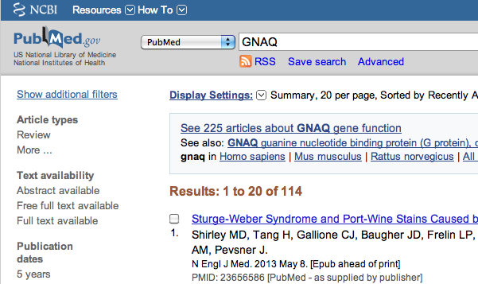
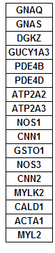

Pathway enrichment analysis using bioinformatic tools save time compared to the traditional approach
my favorite protein
Compute Ontario-summer school 2025 Bioinformatics.ca
Notes:
Pathway enrichment analysis using bioinformatic tools save time compared to traditional approach. What would be the traditional approach?
The traditional approach that would be to look at the list of significant proteins and manually do a pubmed search on those proteins.
There are 2 main issues with this manual approach, the first one is that it is time consuming and the second reason that is directly derived from the first one is that we won't look at all genes or proteins in our list but select the ones based on our interest and therefore we could restrict our analysis to only the top significant ones and we miss some information or we just focus on our favorite gene and this leads to a bias in the interpretation of the results whereas using bioinformatic tool that will automate the task will reduce this bias.

Slide 8
Benefits of Pathway Enrichment Analysis
vs. analysis of individual transcripts, proteins, SNPs…
Results are easier to interpret
Familiar concepts e.g. cell cycle
Improves statistical power
Fewer tests, aggregates data from multiple genes into one pathway
More reproducible
E.g. gene expression signatures
Facilitates integration of multiple data types
Identifies possible causal mechanisms
Predicts new roles for genes
Compute Ontario-summer school 2025 Bioinformatics.ca
Notes:
Here are some benefits of pathway enrichment analysis.
the results are easier to interpret, it is easier to have a clear picture of what happened in our sample cells.
It improves statistical power: it means that even if individually we don't have hits, genes or proteins, lipids that are very significant in our experimental results, by combining the changes of multiple proteins belonging to the same biological process, we can see a statistically significance of this pathway.
Furthermore, the results are more reproducible and it facilitates the integration of multiple data types.

Slide 9
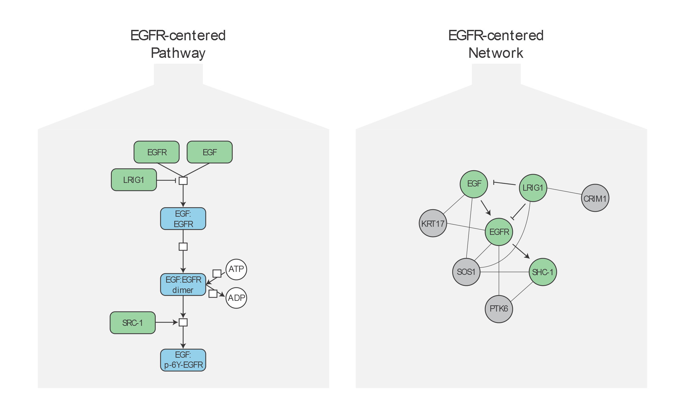
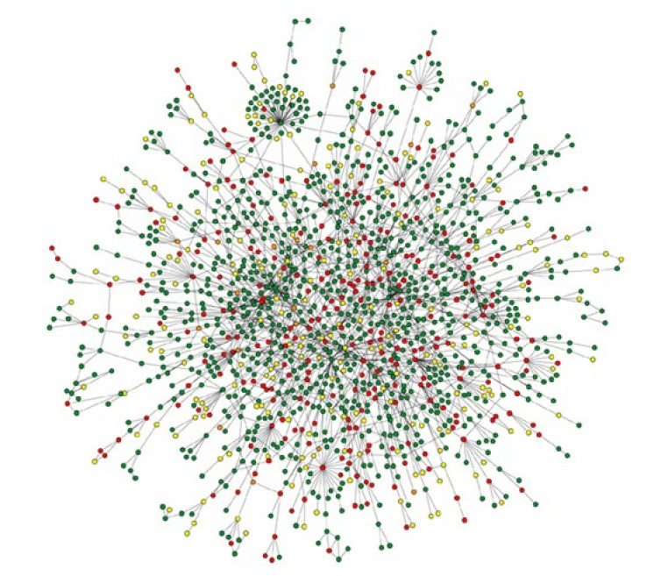
Pathways vs. Networks
- Detailed, high-confidence consensus
- Biochemical reactions
- Small-scale, fewer genes
- Concentrated from decades of literature
- Simplified cellular logic, noisy
- Abstractions: directed, undirected
- Large-scale, genome-wide
- Constructed from omics data integration
Pathway: proteins that are known to work together in a defined biological process.
A network is a representation of a pathway, built using information stored in pathway database
Compute Ontario-summer school 2025 Bioinformatics.ca
Notes:
What do we mean when we talk about pathways and when we talk about networks?
A pathway is basically proteins that are known to work together in a defined biological process. For this pathway, we know the elements , the actions (what the pathway is doing), and elements of the pathway that are activators or inhibitors or downstream events. We also characterize a pathway by upstream and downstream events. Those information comes from research study and well detailed in published paper.
A network is a representation of a pathway , built using information stored in pathway database. What we can see when we compare both pathway and network is that a network is less detailed, we have the components of the pathway but very often we lose the information about activators, inhibitors, upstream and downstream because this is difficult to store these information in databases.

Slide 10
Pathway database
axon guidance
SEMA4A
DNME3
SQLE
F2RL3
aging
We use prior knowledge of pathway stored in gene-set format in pathway
Database. Information about genes in pathways are collected from published papers by curators .
SLC45A3
STON2
NFKB2
stem cell development
LRPAP1
TTC7B
SEMA6B
ARPC1B
cell migration
SIPA1L2 SEMA7A
STK17A
SLC20A2
SH3PXD2A
GADD45B
IL21R
Pathway
Databases
Compute Ontario-summer school 2025 Bioinformatics.ca
Notes:
A very important element of pathway enrichment analysis are the pathway databases.
I have told you that during the pathway enrichment analysis, we are querying our proteins against pathways which are biological processes.
The pathway information in other words the list if genes known to be involved in these pathways are gathered from different publication and the information is stored in the pathway database. In order to use it in our bioinformatic scripts, the format of the pathway database is very simple, it is a text file containg the name of the pathway followed by the list of genes known to be part of this pathway. When the pathway information is stored in this format, we often refers the pathways as gene-sets.

Slide 11
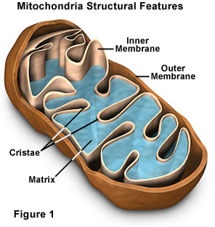
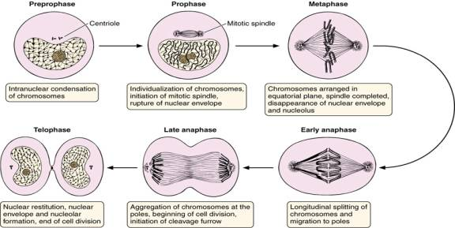
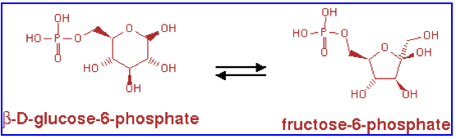
What GO Covers?
GO terms divided into three aspects:
cellular component
molecular function
biological process
glucose-6-phosphate isomerase activity
Compute Ontario-summer school 2025 Bioinformatics.ca
Notes:
The Gene Ontology is I think that largest database and therefore it is a great source of information for us.
The particularity of GO is that it is divided into 3 categories; cellular component,, molecular function and biological process. And this is the category biological process that we often abbreviate as GO BP that is the most interesting when we perform pathway and network analysis because this is the one which stores the information about the signaling pathways

Slide 12
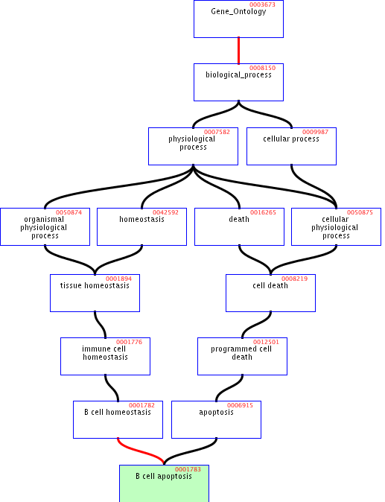
GO Structure
Terms are related within a hierarchy
is-a
part-of
Describes multiple levels of detail of gene function
Terms can have more than one parent or child
Compute Ontario-summer school 2025 Bioinformatics.ca
Notes:
One particularity of the GO database is that it is organized in a hierarchy. You have parent and child terms . The child terms are smaller and more specific pathways.
Here we see an example of this hierarchy. B cell apoptosis is kind of apoptosis which is a kind of cell death which is a kind of biological process. So what we do in the bader lab when we perform pathway analysis is that we removed the very large process that have more than 2000 genes for example per pathways because they are very general terms and not very informative. And what we also do is to present the result of the analysis as networks so that similar child terms that we got in our results cluster together.

Slide 13
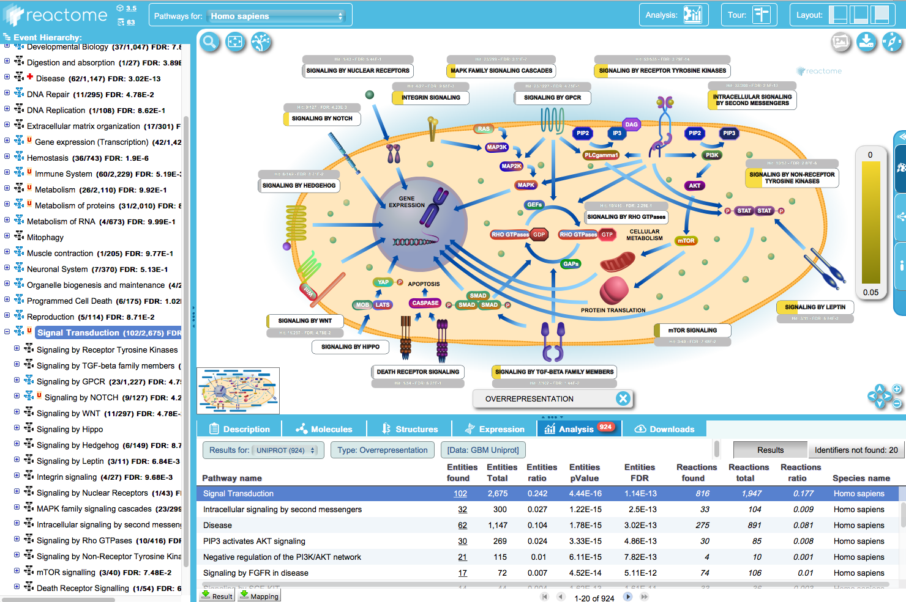
Another database: Reactome
Compute Ontario-summer school 2025 Bioinformatics.ca
Notes:
Another large , very detailed and vey regurlarly updated database that we use as source information is reactome, they have very detailed diagram of the pathways and invite you to visit their website for more information

Slide 14
What a pathway file looks like (showing only a few pathways):
18000 pathways in file
Yellow: proteins that match with my list
Compute Ontario-summer school 2025 Bioinformatics.ca
Notes:
Here is our the file that we used for our pathway analysis. I want to show it to you because it is very simple. Just a text file that list all the pathways collected in the GOBand reactome database. With the name of the pathway and the genes known to be in the pathways. Now we have protein lists and we just look at all the pathways one by one and calculate for each pathway the number of proteins in common in our list and apply the correct statistical test to quantify this overlap;.
As some pathways will have some gene in common and will be similar to each other, we will present the results as a network

Slide 15
BaderLab EM_Genesets
http://download.baderlab.org/EM_Genesets/
GO BP
(13798)
Reactome
(3231 pathways)
NCI Nature
(25 pathways)
Panther
(2019 pathways)
NetPath
(171 pathways)
Human Cyc
(33 pathways)
IOB
(520)
Wiki pathway
Compute Ontario-summer school 2025 Bioinformatics.ca
Notes:
Pathways database are very important element; so we need to use pathway database that are accurate or as accurate as possible.
We need to chose good quality database and very importantly databases that are updated regularly.
In the baderlab, what we have ch.osen to do is to combine several databases together to be more powerful and more sensitive in our analyses because this way we start from more information.

Slide 16
Pathway enrichment analysis is a way to summarize your protein list into pathways to ease biological interpretation of the data
gene list
Pathways (gene-sets):
axon guidance (GO:0007411)
SEMA4A
DNME3
SQLE
F2RL3
aging (GO:0007568)
SLC45A3
STON2
NFKB2
stem cell development (GO:0048864)
LRPAP1
TTC7B
SEMA6B
ARPC1B
cell migration
(GO:0050922)
SIPA1L2 SEMA7A
STK17A
SLC20A2
SH3PXD2A
GADD45B
IL21R
Compute Ontario-summer school 2025 Bioinformatics.ca
Notes:
Here is another visual representation because sometimes we think that pathway enrichment analysis is a complicated concept but it is actually very simple and just a way to organize a list into categories that are biological processes.
Here is our protein list. So we may have the genes in black that are part of axon guidance, or aging or stem cell development. Some genes can be included in different categories but some are not overlapping.
At the end of the analysis, if these pathways are statistically significant, we will focus on these pathways to interpret our experiment.
We understand here that the need to summarize comes from the fact that our list is very large, that we got a lot of hits from our omics experiment. If our gene list is vey small, we may want to interpret it other ways.

Slide 17
Two types of gene lists : defined or ranked protein list.
omics
data
Defined list
of proteins
Ranked list of proteins
Step 0
Fisher’s Exact Test, aka Hypergeometric Test
GSEA for ranked lists.
Multiple test corrections:
Bonferroni correction
False Discovery Rate computation using Benjamini-Hochberg procedure
Step 1
pathway enrichment test
GSEA
modified Kolmogorov-
Smirnov (KS) test
Fisher’s exact
test
pvalue
pvalue
Step 2
correction for multiple hypothesis testing
corrected pvalue
corrected pvalue
Compute Ontario-summer school 2025 Bioinformatics.ca
Notes:
This brings us to a more detailed workflow of pathway enrichment analysis.
We will first see that we can have 2 types of lists, a defined list of proteins or a ranked list and that there are 2 main types of enrichment test depending on the type of gene list we could get from our omics experiment (ranked or not ranked). For a defined gene, the statistical test that we are using is the Fisher’s exact test and for a ranked gene list, we are using a rank based test and we will present GSEA which uses a modified KS test.
Even if the statistical tests are slightly different, they all end up by being a p value associated with each tested pathway the p value estimates the probability that this pathway is enriched in our list by chance only.
As we are testing many pathways at the same time, we need to correct for multiple test correction.
we are going to see this workflow in detail in the next slides.

Slide 18
Types of pathway enrichment analysis
Defined list of proteins (e.g. abundance change > 2-fold)
Answers the question: Are any pathways (gene sets) surprisingly enriched in my protein list?
Statistical test: Fisher’s Exact Test (aka Hypergeometric test)
Ranked protein list (e.g. by differential abundance)
Answers the question: Are any pathways (gene sets) ranked surprisingly high or low in my ranked list of proteins?
Statistical test: GSEA, Wilcoxon rank sum test (+ others we won’t discuss)
Compute Ontario-summer school 2025 Bioinformatics.ca
Notes:
What is the difference between a defined list and a ranked list?
A defined protein list would typically contains a fixed number of proteins . for example 200 or 500 proteins or more . We might have selected these proteins based on their significance and selected the top ones.
The question we are going to ask when doing enrichment analysis wit a defined list is : are there any pathways surprisingly enriched in my gene list . This is an overrepresentation analysis. The statistical test that is used to answer this question is the the fisher’s exact test.
To generate a rank list, we could take for example all proteins that were detected in our assay and rank them by their differential abundance for example from up-regulated to down-regulated .
In this case the question that we are going to ask when doing enrichment analysis is : are there any pathways that are ranked surprisingly high or low in my ranked list of genes. The method that we are going to see is gsea.

Slide 19
Workflow
Fisher’s exact test
modified KS test
Compute Ontario-summer school 2025 Bioinformatics.ca
Notes:
Here is the presentation of our standard workflow for pathway enrichment analysis.
We have basically one workflow where we have a discrete gene list eg frequently mutated genes and a workflow where we have RNAseq comparing 2 conditions like treated and control and where we can generate a rank list. We use gprofiler for the discrete gene list and gsea for the RNAseq data to generate the pathway enrichment results.
Then we upload the output table that is on the right into enrichmentmap to create the network,
And then at a third step that we haven’t talked about yet, we will automatically cluster and annotate the network using the AutoAnnotate app which uses ClusterMaker and WordCloud.

Slide 20
Pathway enrichment analysis using a defined list of proteins
Given:
Protein list: e.g. RRP6, MRD1, RRP7, RRP43, RRP42 (yeast)
Pathways (gene-sets) or annotations: e.g. The Gene Ontology, transcription factor binding sites in promoter
Question: Are any of the pathways(gene-sets) surprisingly enriched in the protein list?
Details:
Where do the gene lists come from?
How to assess “surprisingly” (statistics)
How to correct for repeating the tests
Compute Ontario-summer school 2025 Bioinformatics.ca
Notes:
We are now going to talk a little bit in more detail about the statistical tests and pvalues in pathway enrichement test .
We are going to start with the workflow when we have selected a defined list of proteins using a threshold.
Given a gene list, given a pathway, are any of the gene sets surprisingly enriched in the gene list?
We are now going to see in more details, how to assess SURPRISINGLY

Slide 21
Pathway enrichment analysis calculates the overlap between our protein list and a pathway
gene list
Pathway (gene-set):
overlap
axon guidance (GO:0007411)
My gene list
MYPN
LAMC2
PFKB3
SH2D2A
MDM2
RFX2
IFI30
TUBB3
SEMA3G
SLC45A3
SIPA1L2
TMOD2
SEMA4A
GAB2
SLIT1
LAMA1
ARHGAP19
SEMA7A
DOK4
DOK1
RELN
BDNF
STON2
LRPAP1
SH3PXD2A
COTL1
SEMA5B
PTPRA
EFNB1
VASP
SEMA6B
DNM3
SQLE
LAMA5
BSG
EPHB3
GADD45B
STK17A
F2RL3
SPTB SRC
NFKB2
ATP6V0A1
NRP2
IGSF9
TNR
BDNF
TTC7B
ARPC1B
SLC20A2
EFNA2
SMO
SEMA7A
KIF5C
LGI1
NTRK1
IL21R
GFRA3
LAMA2
ALCAM
SLC20A2
PPIF
BMP2K
PIK3CB
PALLD
PTPN11
DOK4
13
Size of the original
pathway
39
Size of the gene list
41
13/41
13/39
…
~1/3
~1/3
Size = number of genes
FDR<0.05
Compute Ontario-summer school 2025 Bioinformatics.ca
Notes:
This slide illustrates the concept of overlap that is used to calculate most of the enrichment scores.
We have our gene list which consists of 41 genes. And in our genes list, 13 overlap with the axon guidance pathway. This axon guidance is coming from the gene ontology database and contains 39 genes. So 13 out of these 39 overlap with our gene list, and 13 of these genes overlap with 41 genes from our gene list which is about 1 quarter of the genes that are overlapping.

Slide 22
The background represents all the proteins that could have been captured in my omics experiment
gene list
genes not measured
genes measured in the experiment
overlap
My gene list
LAMC2
PFKB3
SH2D2A
RFX2
MYPN
SEMA3G
MDM2
IFI30
TUBB3
SLIT1
LAMA1
SLC45A3
ARHGAP19
SIPA1L2
TMOD2
SEMA4A
GAB2
RELN
BDNF
SEMA7A
SEMA5B
DOK4
DOK1
EFNB1
VASP
STON2
LRPAP1
SH3PXD2A
SEMA6B
COTL1
PTPRA
BSG
STK17A
DNM3
SQLE
LAMA5
EPHB3
GADD45B
F2RL3
SPTB SRC
NFKB2
ATP6V0A1
NRP2
IGSF9
TNR
BDNF
TTC7B
ARPC1B
SLC20A2
EFNA2
SMO
SEMA7A
KIF5C
LGI1
NTRK1
IL21R
GFRA3
LAMA2
ALCAM
SLC20A2
PPIF
BMP2K
PIK3CB
PALLD
PTPN11
DOK4
pathway:
axon guidance (GO:0007411)
estimated 20,000-25,000 human protein-coding genes
How many proteins could have been captured in your experiment? : about 6,000?
FDR<0.05
Compute Ontario-summer school 2025 Bioinformatics.ca
Notes:
Another very important concept to take into consideration while doing enrichment analysis is the background. The background is sometimes called universe and represents the genes and only those proteins that could have been captured in your omics experiment. The proteins that could not be measured or are not expressed in my cells are not part of my background and won’t be counted.

Slide 23

How do simple enrichment tests work?
Enrichment Table
OVERLAP BETWEEN GENE LIST AND GENE_SETS (PATHWAYS)
pathway (gene-set)
Gene-set p-value
Spindle 0.0001
Apoptosis 0.025
gene list
1
39
13
41
2
Is this overlap larger than expected by chance?
gene list
pathway (gene-set)
random sampling
using background genes
Background genes
Empirical pvalue
Compute Ontario-summer school 2025 Bioinformatics.ca
Notes:
How does a simple enrichment test work? Here in pink is our gene list that we have selected using our threshold let s say FDR 0.05.
The enrichment test simply consists of the overlap meaning the number of genes that are shared between our gene list and our tested pathway.
But then the next step is to calculate the p-value that is assessing the probability that the overlap is at least as large or larger compared to the overlap that you would obtain by just randomly selecting a gene list from the background.
So ,one way to calculate this pvalue is to build a null distribution by selecting random genes multiple times (same size as the original list) and compute the overlap between the tested pathway and the random gene list and do it for example 1000 times. zThe pvalue is then the number of times the random overlap was as large or larger than the observed overlap divided by the total number of trials. A pvalue derived that way is called an empirical pvalue.
The problem is that you need to do a lot of random selection to obtain a good p value precision and the computer may take a lot of time to compute it. However under some conditions, we know what the distribution of the random samples looks and we can directly use statistical tests. In the case of enrichment analysis the fisher’s exact test and the hypergeometric distribution is the appropriate statistical test to use.

Slide 24

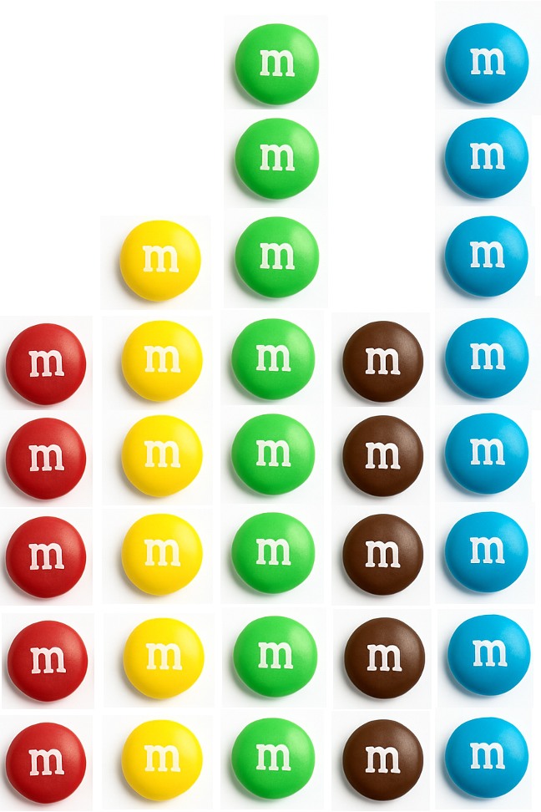


Do you need to learn more about Fisher’s exact test?
StatQuest with Josh Starmer
gene sets (pathways)(
1 bag of m&m’s
(= my universe)
My “sample”= my gene list
m
On the left, all the m&m’s in the bag sorted using the different colors. I take a random “sample” of m&m’s from the bag, and I would like to determine if my sample is special.
Background
VIDEO the M&M’s examples:
https://www.youtube.com/watch?v=udyAvvaMjfM
Compute Ontario-summer school 2025 Bioinformatics.ca
Notes:
After these explanations, If you still need to learn about the fisher’s exact test I would recommend this nicely video from stat quest. So in this example, they use a m and m’s bag and the background is represented by all the m and m’s in the bag. And the the different m and m’s colors represent different pathways and we draw randomly 8 m and m’s and 7 are blue and 1 is red and this represent our gene list!

Slide 25
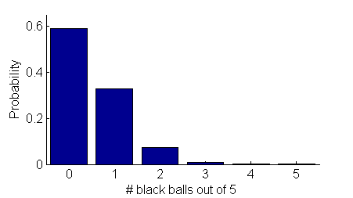
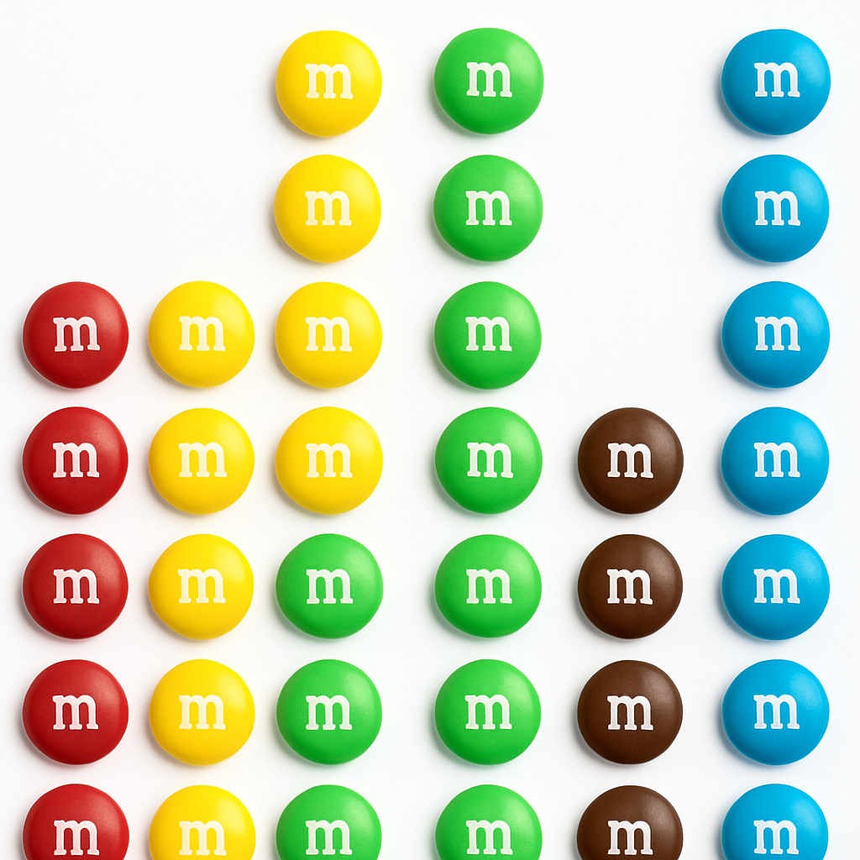






The Fisher’s exact test a.k.a., hypergeometric test
“my sample”
Null distribution
Gene list
RRP6
MRD1
RRP7
RRP43
RRP42
Answer = 0.001066662
P-value
Background population:
500 black m&m’s,
4500 red m&m’s
4.7. 10-7
1 gene-set/pathway
0.5766
0.3516
0.06697
0.0046
0.00106
Notes:
The fisher’s exact test is using the hypergeometric distribution to calculate each probability and the pvalue.
Using this distribution, we can directly calculate the probability of getting 0 black ball. The probability of getting 5 red balls is high because there are much more red balls in the box. Then we can calculate the probability of getting 1 black balls, 2 black balls, 3 black balls.
Then we need to go from probability to pvalue and the p value associated with our result (4 black balls) is the
probability to get 4 or more than 4 black balls. (the pvalue is the sum of getting the same result or something that is more rare than the result)
Now if we adapt our teaching example to pathway enrichment analysis, the black balls represent one pathway let s say apoptosis and contains 6 balls in the original gene ontology pathway database. And our gene list contains 5 genes and 4 of these genes are in the apoptosis gene-set. Is apoptosis overrepresented in our gene list?
Our pvalue of 0.001 is close to 0 meaning that the chance of rejecting the null hypothesis when the null hypothesis is still true (random) is extremely low. Therefore, we can reject the null hypothesis and conclude that the apoptosis pathway is significantly enriched in our gene list and it is probably not due to random chance.

Slide 26
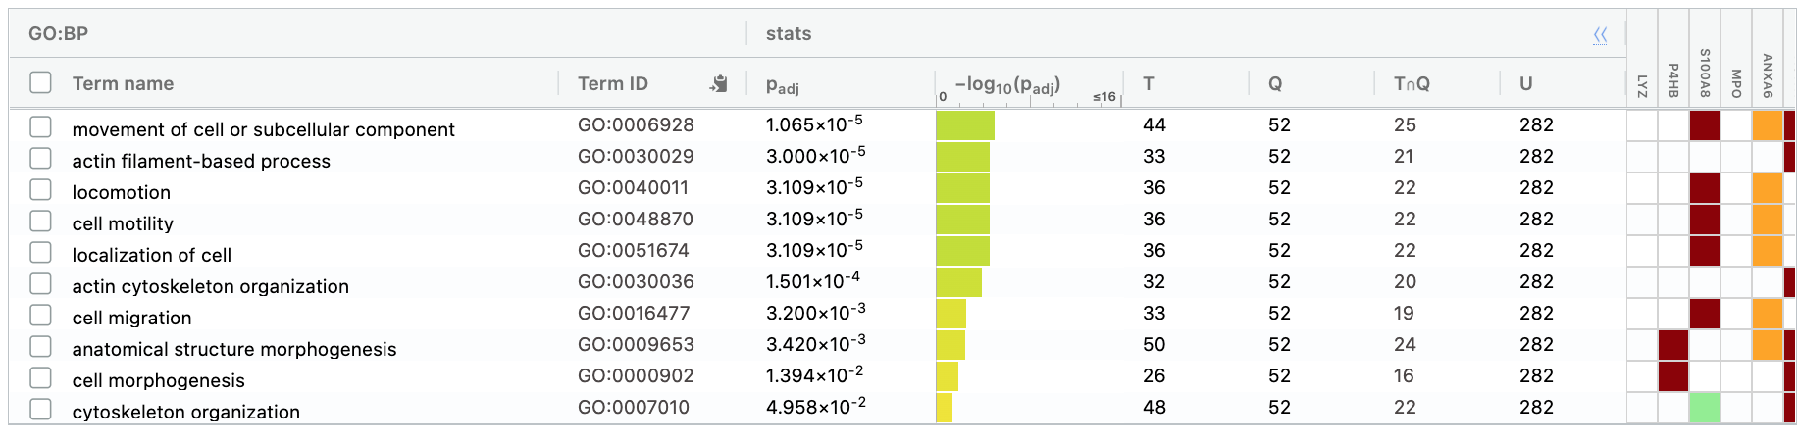
T (term): pathway that is being tested
Q (query): my gene list
TnQ: overlap between pathway and gene list
U (universe): background
19
25
27
293
 | In protein list | Not in protein list
In pathway | 25 | 27
Not in pathway | 19 | 266
 | 52 | 293
2x2 contingency table
Fisher’s exact test
Compute Ontario-summer school 2025 Bioinformatics.ca
26

Slide 27
We are testing many pathways at the same time
p<0.05 ?
Test many
pathways
We need to correct for multiple hypothesis testing
Compute Ontario-summer school 2025 Bioinformatics.ca
Notes:
In order to interpret the results of our experiment , we are trying to test as many pathways as possible and we will need to correct for multiple hypothesis testing.

Slide 28
How to win the p-value lottery
Correction for Multiple Hypothesis Testing
Random draws
Expect a random draw with observed enrichment once every 1 / P-value draws
… 7,834 draws later …
Background population:
500 black genes,
4500 red genes
1 gene-set (apoptosis)
Compute Ontario-summer school 2025 Bioinformatics.ca
Notes:
we are going back to our example of red and black balls, our background is 5000 balls containing 5 black balls and we want at least 4 black balls. The pvalue was telling us that we had only 0.001% chance to get that by random chance only but this is if and only if we do only one trial. Because if we try and try again until we succeed, we will get a draw with 4 black balls and 1 red balls. So even if an event is unlikely, if we try it multiple times, we may able to get it. And this is what people mean by multiple hypothesis testing and that s why we need to correct for the number of tests we are making.
So if we don't correct for multiple hypothesis testing, we are going to generate type I error also named false positive, we are going to get situations where the enrichment that we see in that pathway could be due to random chance even if the pvalue was low. That’s why again we have to correct for the number of pathways that we have tested.

Slide 29
Correction for Multiple Hypothesis Testing
1. Simple P-value correction: Bonferroni
If M = # of gene-sets (pathways) tested:
Corrected P-value = M x original P-value
2. False discovery rate (FDR)
FDR is the expected proportion of the observed enrichments due to random chance.
Typically, FDR corrections are calculated using the Benjamini-Hochberg procedure.
FDR threshold is often called the “q-value” or “adjusted pvalue”
Extract the pathways
that are significant at FDR 0.05 or less
Compute Ontario-summer school 2025 Bioinformatics.ca
Notes:
There is actually a simple way to correct for multiple tests and intuitivally you could mutliply the pvalue that you obtained for each gene-set by the total number of gene-sets that we have tested.
This correction exists and it is called the bonferroni correction. The corrected pvalue will always be greater than the original pvalue.
You would then select all the gene-sets that have this corrected pvalue equal or less than 0.05 and interpret your results. It is to known that this correction is very stringent and actually the stringest method that exists and you may have no gene-sets that passed that threshold (loss of power. If you have gene-sets that pass that threshold, you can be pretty confident when you report them as enriched.
When we use the bonferroni correction, we said that we are controlling for the family wise error rate and it means that when we select the pathways under correcter pvalue of 0.05 , we say that the probability of any one of them to be a type one error is 5%.

Slide 30
Frequently mutated genes
EXAMPLE WITH A DEFINED GENE LIST
Compute Ontario-summer school 2025 Bioinformatics.ca

Slide 31
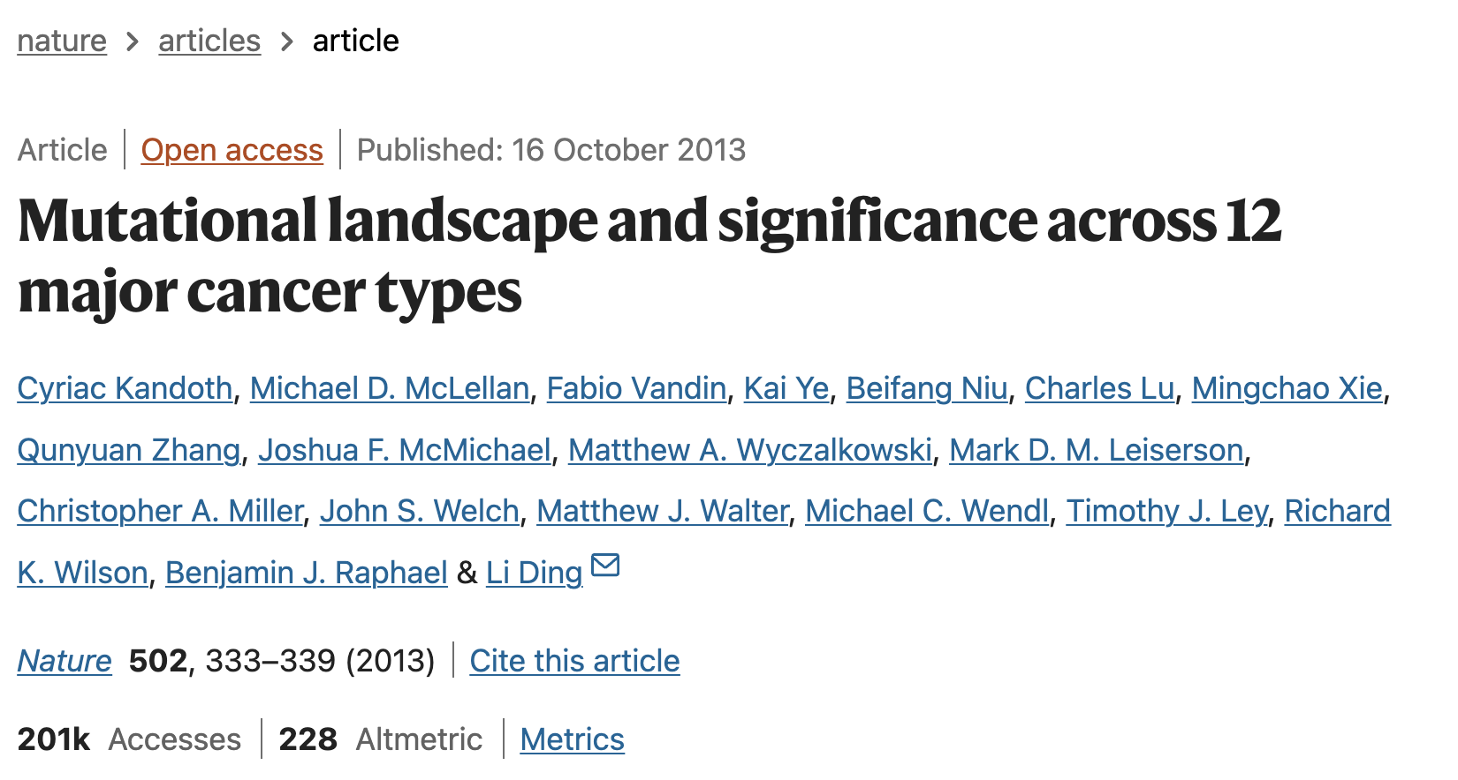
Compute Ontario-summer school 2025 Bioinformatics.ca

Slide 32
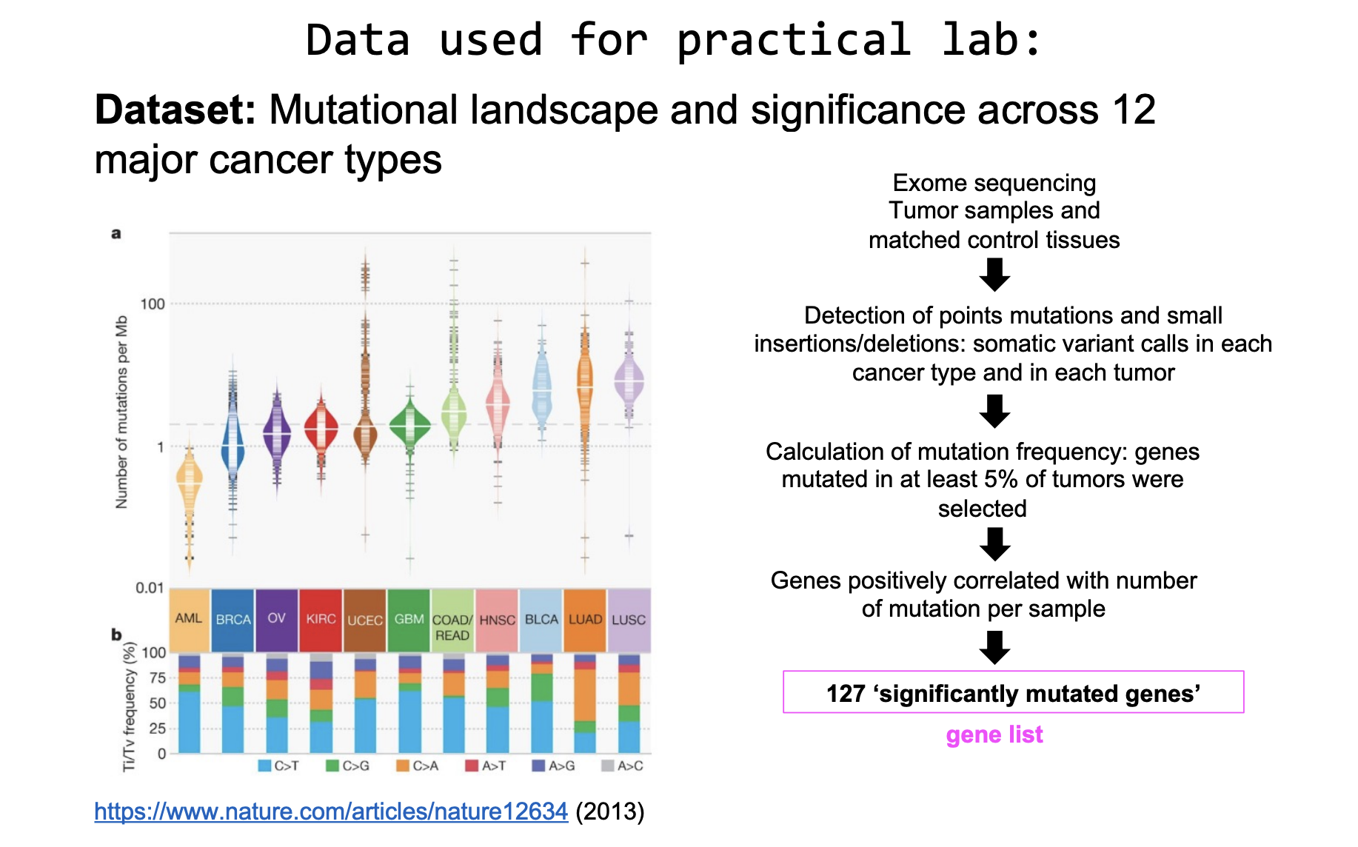
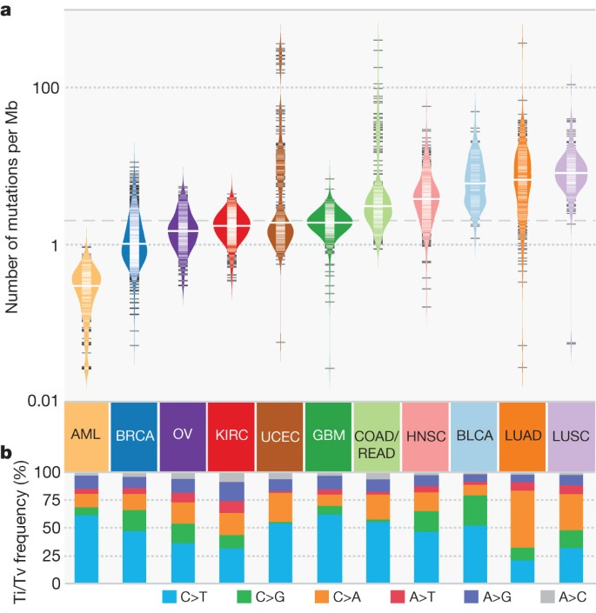
Compute Ontario-summer school 2025 Bioinformatics.ca
Notes:
point mutations and small insertions/deletions from 3,281 tumours across 12 tumour types as part of the TCGA Pan-Cancer effort
we identified 127 significantly mutated genes
The average number of mutations in these significantly mutated genes varies across tumour types; most tumours have two to six

Slide 33
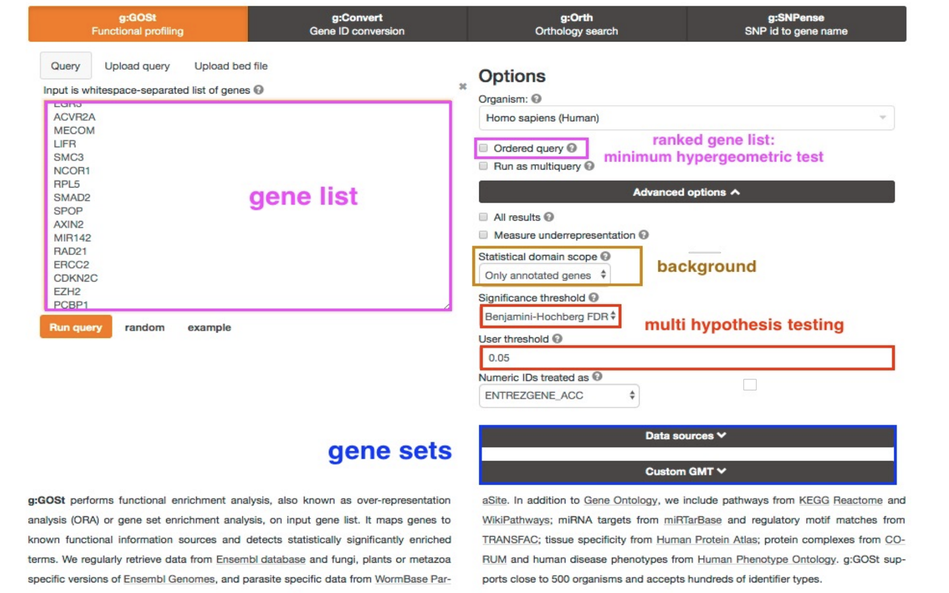
g:Profiler
Compute Ontario-summer school 2025 Bioinformatics.ca

Slide 34
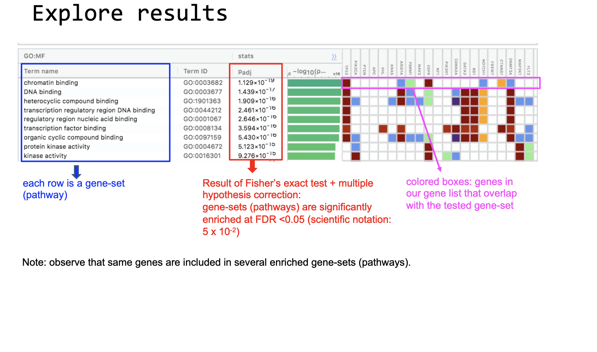
Compute Ontario-summer school 2025 Bioinformatics.ca

Slide 35
During the practical lab:
We will run g:Profiler from R
Compute Ontario-summer school 2025 Bioinformatics.ca

Slide 36
More tools (comparisons)
ClusterProfiler
ActiveDriver
Roast/Camera
gPRofiler
Compute Ontario-summer school 2025 Bioinformatics.ca

Slide 37
Summary of the Steps
1) Get our gene list
Identification genes with mutations present in at least 5% of the tumor samples
Format gene list using official gene symbol
2) Perform pathway enrichment analysis (g:Profiler) or other equivalent tools
the first step is to calculate the overlap size between each tested pathway and our list of proteins
the second step is to estimate the probability (p value) that the enrichment happened by chance only using a Fisher’s exact test
the pvalue is corrected for multiple hypothesis testing (adjusted p value)
the output is a list of pathways that are enriched in our list of proteins; we select the pathways enriched with a corrected pvalue less than 0.05 .
3) Visualized the results as a network (optional, see part2)
The output table contains a lot of pathways that are similar and share some proteins in common; the table might be difficult to read or interpret.
We can visualize the table as a network which will group the similar pathways together and enables us to identify 11 groups of biological functions enriched in our protein list. The network is easier to interpret and presents an unbiased way to interpret the data.
Compute Ontario-summer school 2025 Bioinformatics.ca

Slide 38
This module is taken from
CBW Pathway and Network Analysis Workshop 2024
Original source of the slides: Quaid Morris/Gary Bader/Lincoln Stein/Juri Reimand
Compute Ontario-summer school 2025 Bioinformatics.ca
Notes:
We are affiliated with Bioinformatics.ca

Slide 39
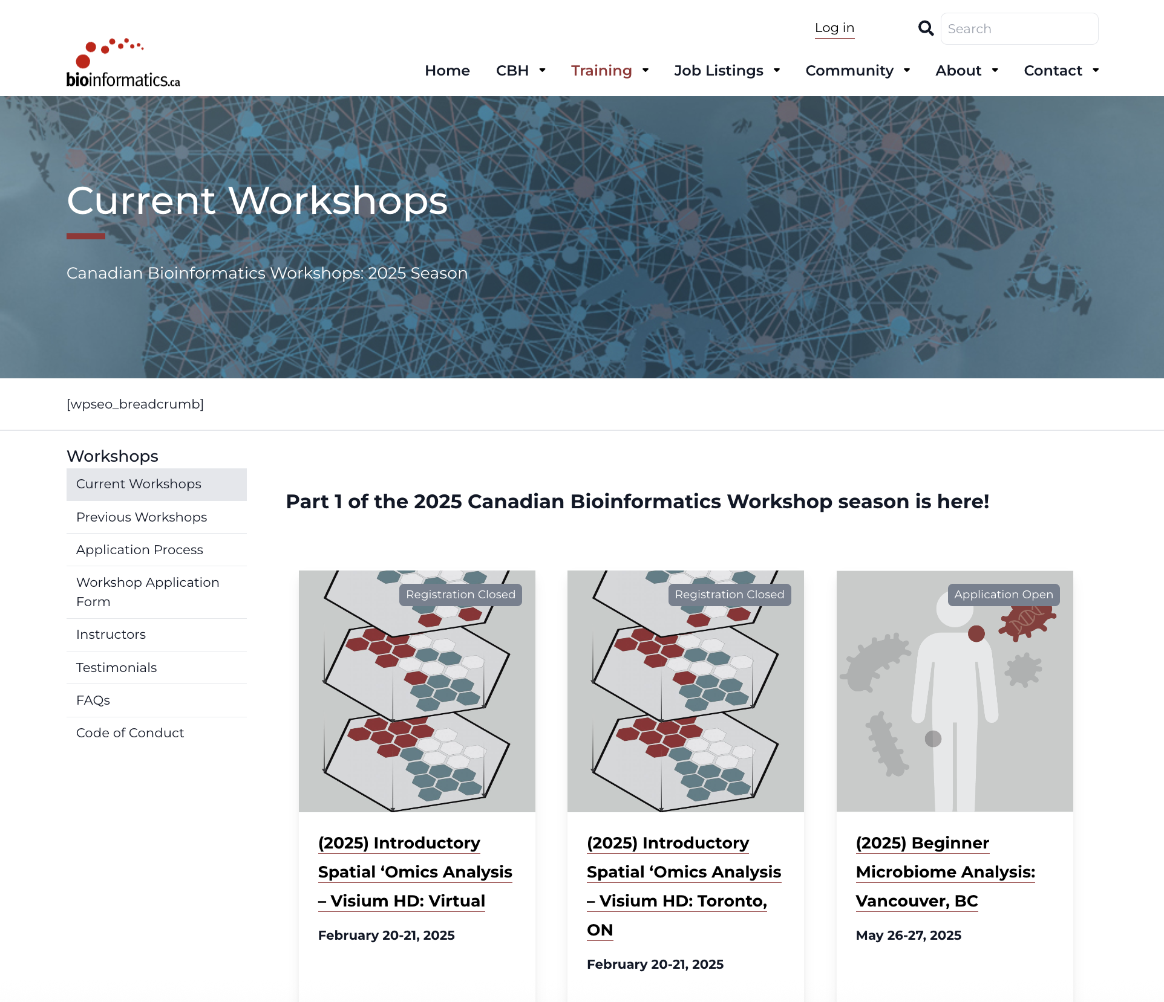
2025 Canadian Bioinformatics Workshop
Please visit the website to see workshops presently offered
https://bioinformatics.ca/workshops/current-workshops/

Slide 40
Time for practical lab
LINK TO GITHUB
Compute Ontario-summer school 2025 Bioinformatics.ca

